Slide 1
Playback Session
Date -8th Mar 2023

Slide 2
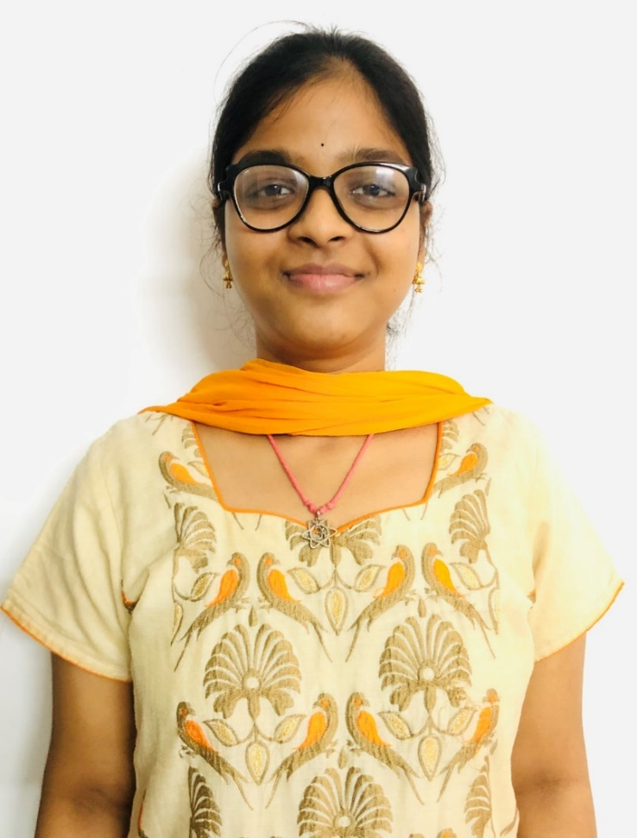
Akula Sai Bala Siva Jyothika
Akula Sai Bala Siva Jyothika
Senior Software Engineer
ERS T&S _SIE-SIE-OISV&Fintech-DU2
Personal Projects
EMPLOYEE MANAGEMENT SYSTEM
Role: Developer
Objectives:
In EMS where we will record all the Employee details.
Create a menu driven application ,create the classes Employee with below details like: (Add, Modify, Remove, Display, Report Generation)
INVENTORY MANAGEMENT SYSTEM (HACKATHON)
Role: DevOps
Objective:
Managing stocks sold from the inventory and displaying the profits of the day designed using frontend and backend technologies,deployed using docker,Kubernetes in tomcat server.
Personal Tasks And Hands-On:
Deployed Docker image and pushed to Docker Registry using Jenkins Pipeline Script.
Created Pipeline job in Jenkins,to push a sample application to Tomcat server.
Created a Pipeline Job to push the Docker Image into Kubernetes Cluster.
Launched EKS Cluster Using Terraform Script .
Configured 2 Worker nodes with 1 Master node and deployed Sample application in Kubernetes.
Deployed a sample NGINX application on Kubernetes cluster.
Business Impact & Relevance for Payment Hub Program
Bachelor of Technology in Electronics and Communication Engineering.
Good hands-on experience in various Devops tools.
Worked as a intern for 6 months and joined as Full time employee in Aug 30.
Enthusiastic and keen to learn new technologies.
Certifications:
Aws Cloud Practitioner Essentials.
DevOps Basic Certification
Tools and Framework Experience
AWS-Cloud Technologies
Git-Version Control System
Jenkins-CI/CD
Docker-Containerization
Kubernetes-Container Orchestration
Terraform -Infrastructure as a Code
Basic knowlegde on Linux and shell scripting.
MySQL-Database Technologies
Monitoring Tools-Basic Knowledge on Dynatrace,Splunk,Grafana,Prometheus

Slide 3
What I have learnt
My SQL
SQL Concepts and Queries
SQL Tables
SQL Selecting,Ordering and Filtering
Table Design:Table,Columns and Numbers
Table Design:Functions and Strings
Multiple SQL Tables
Linux/Shellscript
Overview of Linux OS,Linux file system,Types of shell
Basic Commands
Copy,Move,Remove file/directory
Sort,Cut,Fetch
File permissions,Pattern searching
POC Tasks
Previous week
Current week
27thfeb -3rdmar
6th mar -10th mar
Dynatrace
Monitoring
Types of monitoring
What dynatrace monitors
Uses of Dynatrace
Dynatrace setup
Infrastructure monitoring
Database monitoring
Service monitoring
Splunk
Splunk Overview
Splunk indexes and users
Splunk visualization
Splunk monitoring
ITIL Recordings

Slide 4
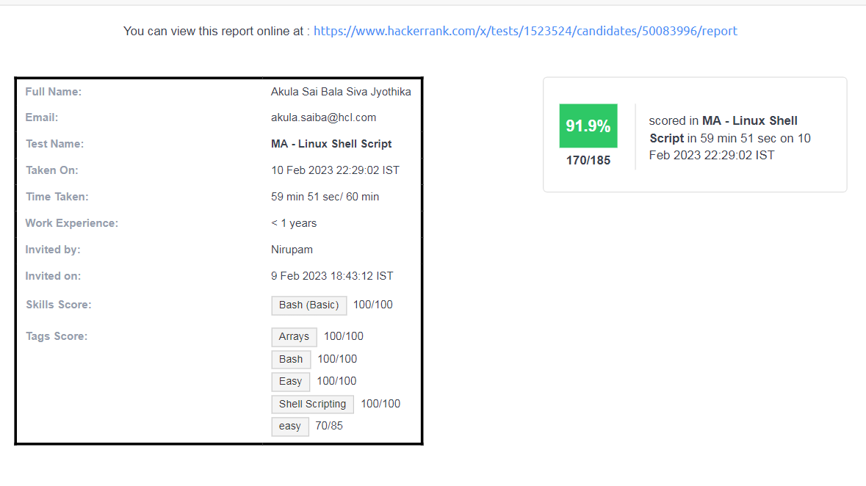
Hackerrank score :

Slide 5
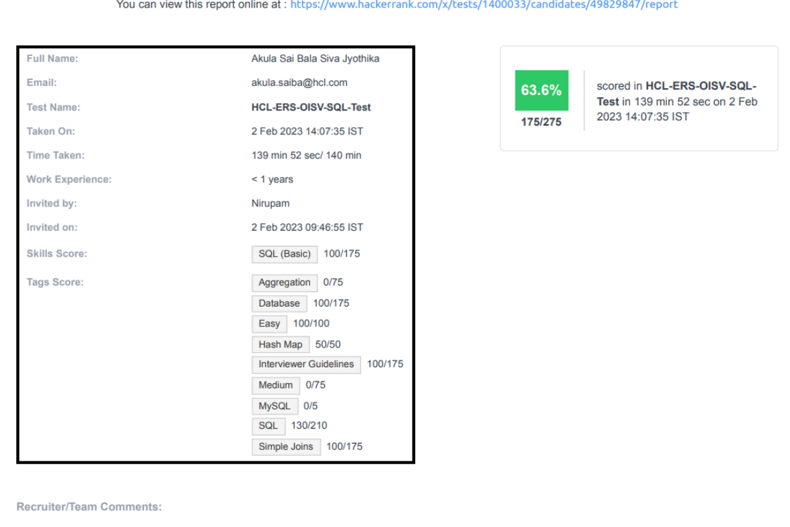

Slide 6
Current week Learning topics
Basic overview of splunk
Splunk installation in VM
Splunk visualization
ITIL recordings
recordings

Slide 7
Incident Management is the process that determines how business customers view the performance the service and the Service Provider.
Incident includes disruption reported by users.
The incidents are automatically detected and reported by monitoring tools
Based on impact, urgency and priority the incidents are classified.
Impact-measure of effect of incident
Incident Management

Slide 8
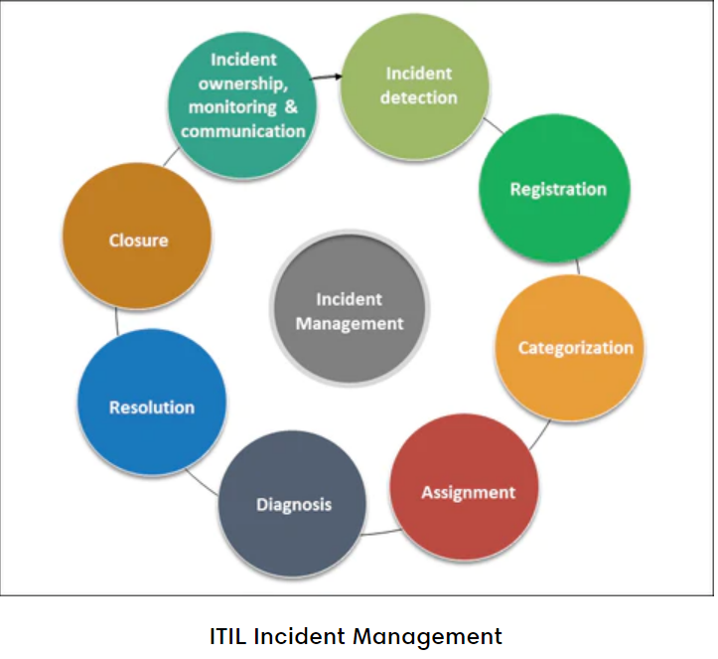
Lifecycle of Incident Management

Slide 9
Faster problem resolution
Prevention of Future Incidents
Better user experience
Customer Satisfaction
Advantages of
Incident
Management

